Slide 1
Movie review project
Data mining

Slide 2
Introduction
The purpose of this code is to perform sentiment analysis on movie reviews using machine learning techniques. Sentiment analysis, also known as opinion mining, is a computational approach that aims to determine the sentiment or emotional tone expressed in a piece of text, such as a movie review.

Slide 3
Background Information
In this analysis, we work with two datasets: the IMDB dataset and a test dataset. The IMDB dataset contains a collection of movie reviews along with their associated sentiments (positive or negative). The goal is to train a machine learning model using the IMDB dataset to understand the sentiments expressed in these reviews.
Once the model is trained, it can predict the sentiment of new, unseen movie reviews. The code includes data preprocessing steps, text cleaning, feature extraction using TF-IDF (Term Frequency-Inverse Document Frequency) vectorization, and the utilization of a Random Forest Classifier for sentiment prediction.
By analyzing movie reviews in this way, we can gain insights into the sentiments of viewers, which can be valuable for various applications, including recommendation systems, market research, and understanding audience preferences in the film industry.

Slide 4
Dataset Loading
# Load the datasets
imdb_data = pd.read_csv('IMDB Dataset.csv',nrows=35000)
test_data = pd.read_csv('test.csv',nrows=14000)

Slide 5
Sentiment distribution in imdb dataset
# Plotting sentiment distribution in the IMDB dataset
plt.figure(figsize=(6, 4))
sns.countplot(x=imdb_data['sentiment'])
plt.title('Sentiment Distribution in IMDB Dataset')
plt.xlabel('Sentiment')
plt.ylabel('Count')
plt.show()

Slide 6
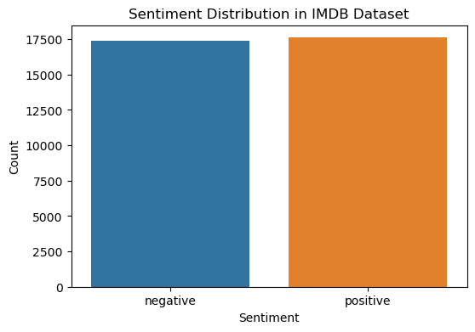
Sentiment distribution in imdb dataset

Slide 7
Data Pre-processing
Lowercasing
Removing HTML Tags
Removing URLs
Removing Special Characters
Stop word Removal
Lemmatization
Negation Handling

Slide 8
Data pre-processing
# Compile the negation pattern outside the function
negation_pattern = re.compile(r'\b(not|no)\b[\s]+([a-z]+)') # Improved function for text cleaning and lemmatization
def clean_and_lemmatize_text(text):
# Lowercasing and removing HTML tags
text = text.lower()
text = re.sub('<br />', '', text) # Removing URLs and special characters
text = re.sub(r"https?\S+|www\S+|http\S+", '', text, flags=re.MULTILINE)
text = re.sub(r'\@w+|\#', '', text)
text = re.sub(r'[^\w\s]', '', text)

Slide 9
Data pre-processing
# Improved negation handling
text = negation_pattern.sub(r'\1_\2', text)
# Removing stopwords
stop_words = set(stopwords.words('english'))
words = text.split()
filtered_words = [word for word in words if word not in stop_words]
# Lemmatization
lemmatizer = WordNetLemmatizer()
lemmatized_words = [lemmatizer.lemmatize(word) for word in filtered_words]
return ' '.join(lemmatized_words)

Slide 10
WORLD CLOUD
# Assuming `imdb_data` is your DataFrame with 'cleaned_review' and 'sentiment' columns
positive_reviews = imdb_data[imdb_data['sentiment'] == 'positive']
negative_reviews = imdb_data[imdb_data['sentiment'] == 'negative'] # Function to generate word cloud and plot
def generate_wordcloud(data, title):
text = ' '.join([word for word in data['cleaned_review']])
wordcloud = WordCloud(max_words=500, width=1600, height=800, background_color='white').generate(text) plt.figure(figsize=(10, 6))
plt.imshow(wordcloud, interpolation='bilinear')
plt.axis('off')
plt.title(title, fontsize=16)
plt.show()

Slide 11
WORLD CLOUD
# Plot positive sentiment word cloud
generate_wordcloud(positive_reviews, 'Word Cloud - Positive Sentiment')
# Plot negative sentiment word cloud
generate_wordcloud(negative_reviews, 'Word Cloud - Negative Sentiment')

Slide 12
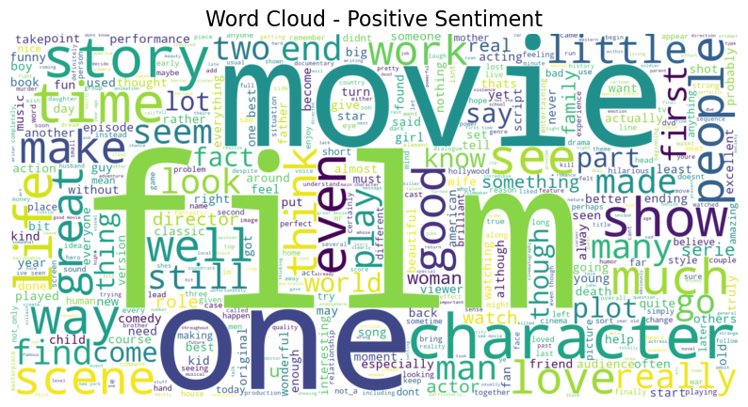
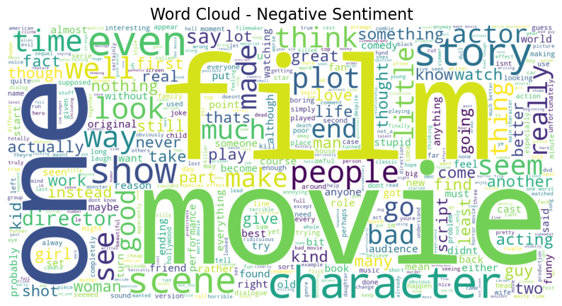
output

Slide 13
Model Building
Algorithm: Random Forest Classifier
# Fit TF-IDF Vectorizer once outside the pipeline
tfidf_vectorizer = TfidfVectorizer(max_features=35000, min_df=5, max_df=0.7, ngram_range=(1, 2))
X_train_tfidf = tfidf_vectorizer.fit_transform(imdb_data['cleaned_review'])
X_test_tfidf = tfidf_vectorizer.transform(test_data['cleaned_review'])
# Setting up the pipeline with RandomForestClassifier
pipeline = Pipeline([
('tfidf', tfidf_vectorizer),
('classifier', RandomForestClassifier(n_estimators=100,random_state=42))
])

Slide 14
Training and Evaluation
Model Training
The sentiment analysis model is trained on the IMDb dataset using a Random Forest Classifier.
Evaluation Metrics
Accuracy Score: Measures overall model accuracy.
Precision: Proportion of true positives among positive predictions.
Recall: Proportion of true positives among actual positives.
F1-Score: Harmonic mean of precision and recall.
Confusion Matrix: Provides detailed true positives, true negatives, false positives, and false negatives.

Slide 15
Training and Evaluation
Interpretation of Metrics
Accuracy: Higher is better overall.
Precision: Fewer false positives.
Recall: Better identification of positive cases.
F1-Score: Balances precision and recall.
Confusion Matrix: Detailed error analysis.

Slide 16
Results
Accuracy on Test Set: 0.8602142857142857
Classification Report on Test Set:
precision recall f1-score support
0 0.86 0.86 0.86 7075
1 0.86 0.86 0.86 6925
accuracy 0.86 14000
macro avg 0.86 0.86 0.86 14000
weighted avg 0.86 0.86 0.86 14000

Slide 17
Confusion matrix
conf_matrix = confusion_matrix(y_test, y_pred_test)
# Display the confusion matrix
plt.figure(figsize=(8, 6))
sns.heatmap(conf_matrix, annot=True, fmt='d', cmap='Blues', xticklabels=['Negative', 'Positive'], yticklabels=['Negative', 'Positive'])
plt.title('Confusion Matrix')
plt.xlabel('Predicted')
plt.ylabel('Actual')
plt.show()

Slide 18
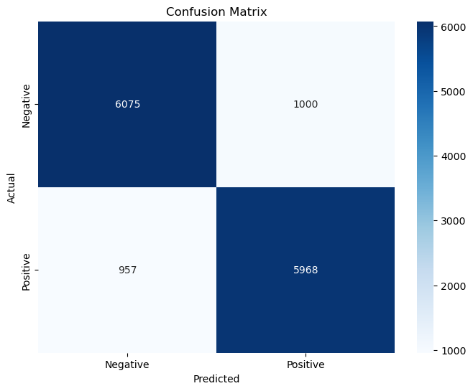
output

Slide 19
FOR FUTURE PREDICTION
# Function to predict new reviews
def predict_new_review(new_review, pipeline):
cleaned_review = clean_and_lemmatize_text(new_review)
return 'positive' if pipeline.predict([cleaned_review])[0] == 1 else 'negative'
# Example usage
new_review = "i found it very heart touching movies of the year"
predicted_sentiment = predict_new_review(new_review, pipeline)
print(f"The predicted sentiment for the new review is: {predicted_sentiment}")
The predicted sentiment for the new review is: positive

Slide 20
Thank you!

